Slide 1
JSCOPE Presents…
Fund Good Deeds
JSCOPE Team: Connor Bashaw, Oliver Gomes, Jonathan Ho, Patrick Lebeau
Notes:
Connor
Hi everyone, we’re Team 1a — FundGoodDeeds. I’m Connor, with me are Jon, Patrick, and Oliver. We’ll cover design, decisions, We’ll show our V1.0 for a quick demo, and wrap with next steps.
One‑liner: Community‑driven fundraising where donors fund specific Needs or Bundles and see live fulfillment.
Agenda: Problem & Goals → Scope → Architecture & Patterns → Domain → Demo → Team/Process → Q&A

Slide 2
PROBLEM & GOALS
Problem: Donors want transparent, immediate feedback that their contribution pushes a specific Need to fulfillment.
V1.0 Goals (today):
Create a Need (description, cost)
Donate to a Need (recorded in Ledger)
Observer updates views automatically
Fulfilled state when fundedAmount ≥ cost
Notes:
Connor
Our problem statement: donors want transparency and immediate feedback that their money actually moves a specific Need toward fulfillment.
For R1 our goal is one reliable, end-to-end flow: an Admin creates a Need with a description and cost, when a donation is made, our view updates automatically, when fundedAmount meets cost, it flips to Fulfilled. We prioritized that instant feedback loop updating csvs over extra features, so the core feels responsive and trustworthy.”

Slide 3
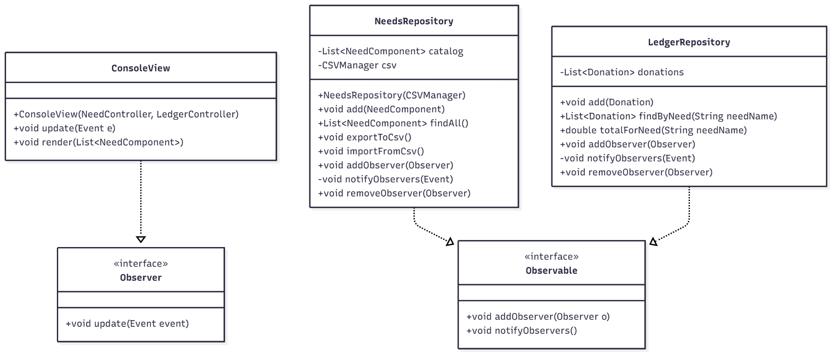
Observer Pattern
Notes:
Connor
We have two observables: NeedsRepository and LedgerRepository. Each implements Observable and exposes addObserver, notifyObservers, and removeObserver.
ConsoleView implements Observer.update(Event e) and subscribes to both repos through their controllers.
Flow: when a need is added or we import/export in NeedsRepository, or when a donation is recorded in LedgerRepository, the repo fires notifyObservers(new Event(...)). The ConsoleView receives update(e) and calls render(findAll()) to redraw the catalog with current totals.
“We chose Observer , Models raise events when state changes, and the View subscribes. That gives instant UI updates, less coupling, and no refresh timers. When a donation posts, the model emits an event, the view re-renders automatically.”

Slide 4
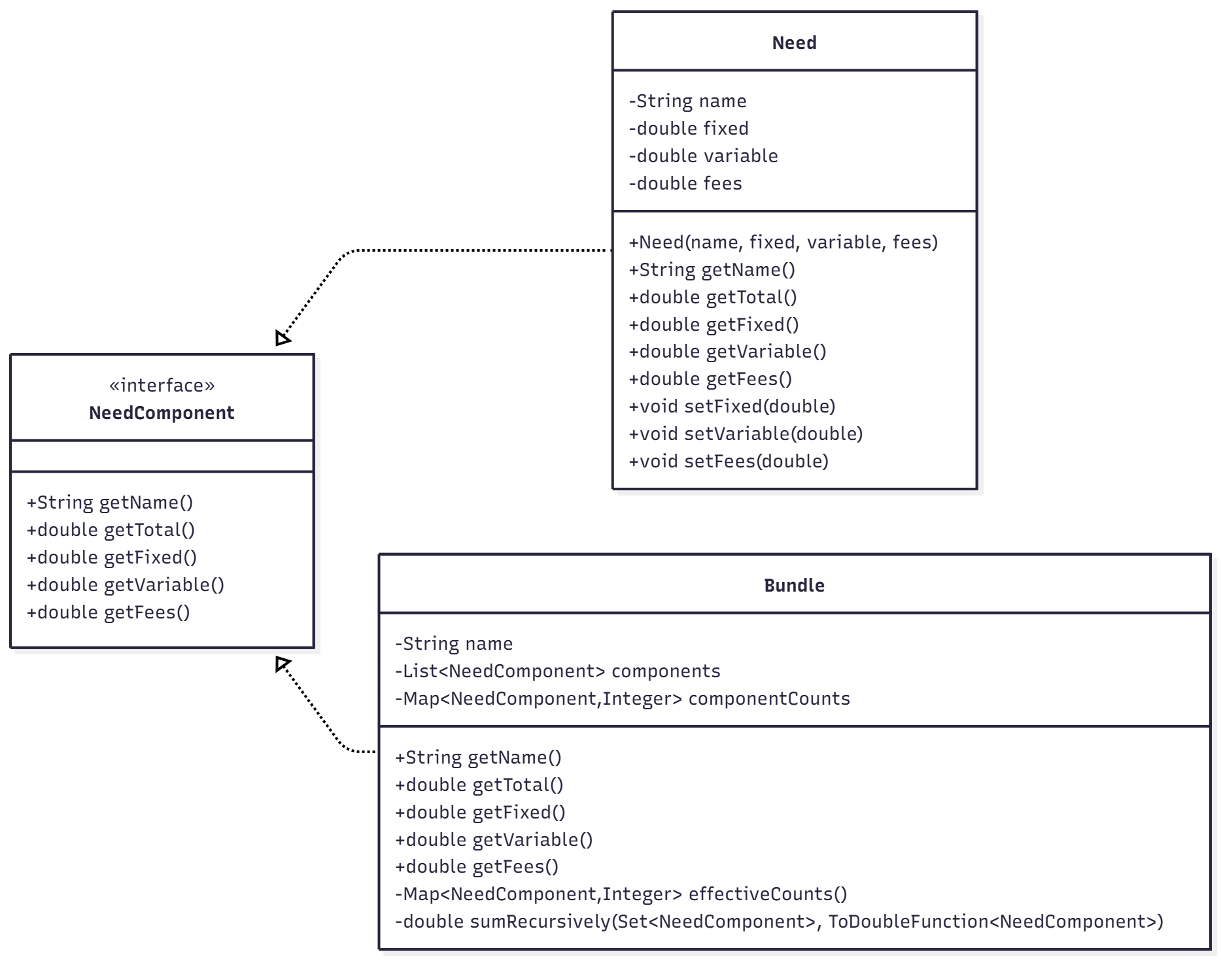
Composite Pattern
Core Functionality:
Shared interface
Bundle(s) in Bundle capabilities
Important recursive functions:
getName()
getTotal()
Notes:
Connor
Alright, this slide is our Composite pattern.
The idea: we want to treat a single Need and a Bundle-of-Needs the same way, so higher-level code doesn’t care which it’s dealing with.
Need component allows other pieces of model, to reference interface which makes it easy to use as a parameter for general functions.
We do that with the NeedComponent interface—two key recursive functions: getName() and getTotal().
A plain Need implements it and returns its own numbers: fixed, variable, and fees rolled into a total.
A Bundle also implements it, but instead of holding amounts, it holds a list of NeedComponents. When you call getTotal(), the bundle sums each child’s total—so bundles can contain needs or other bundles, and it just works.

Slide 5
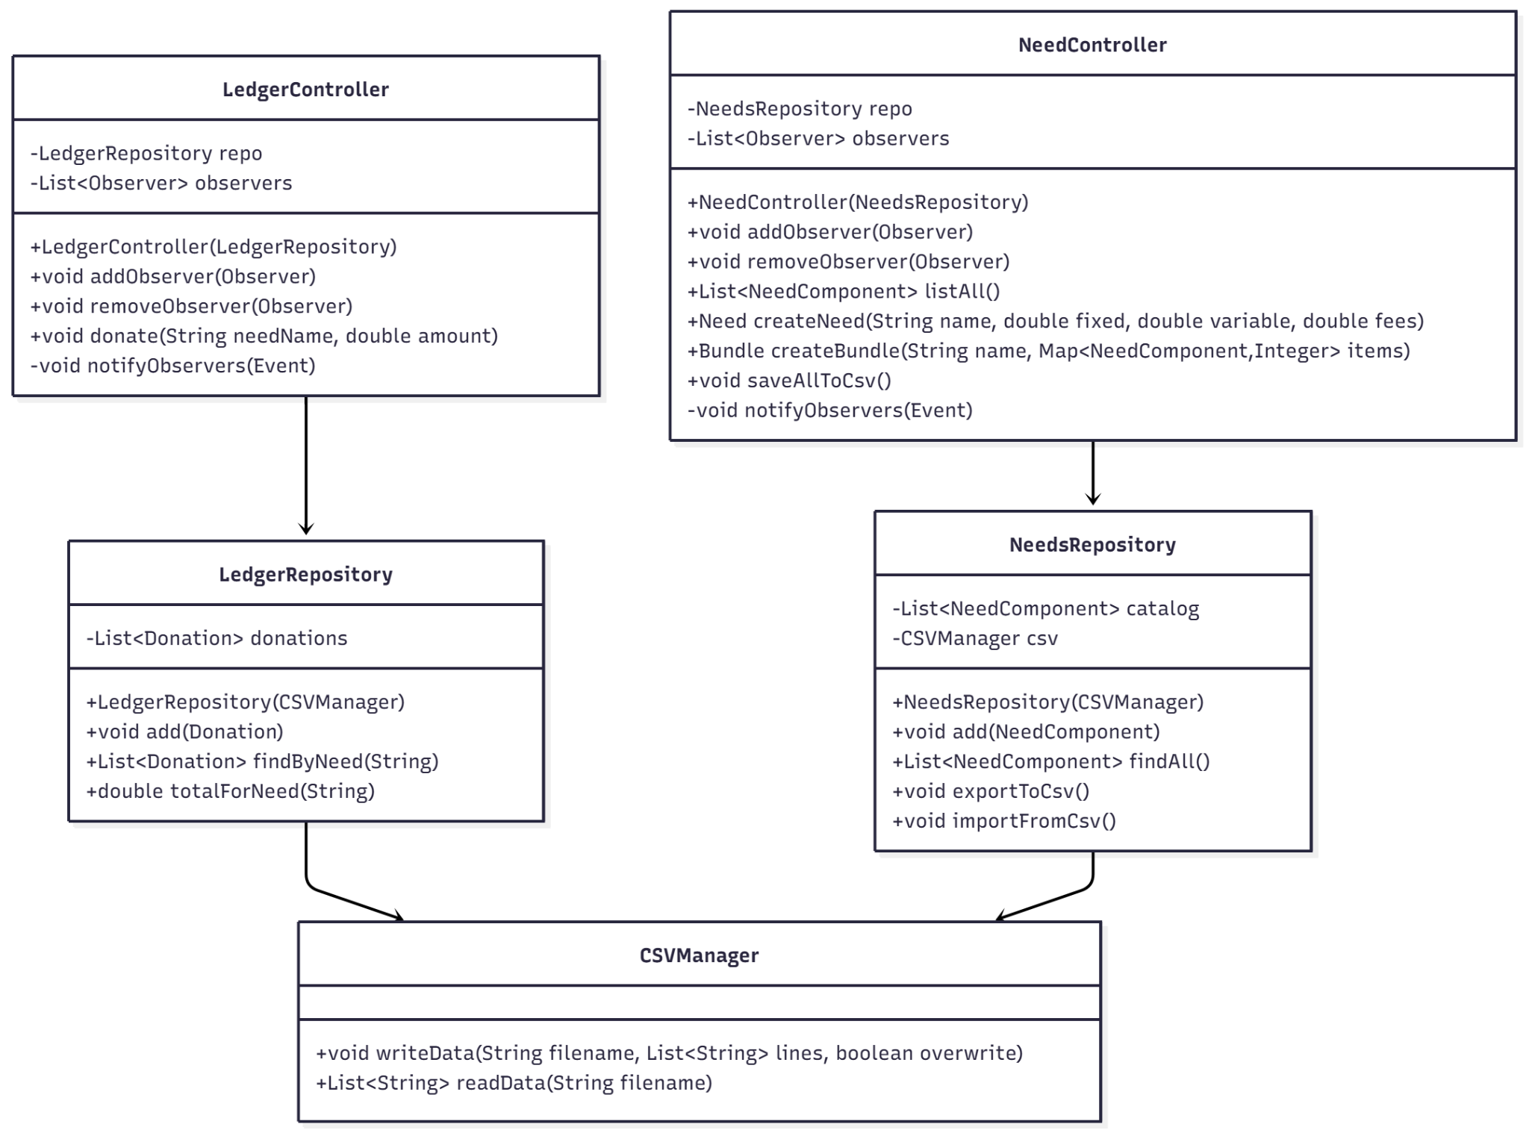
Core Principles
Strengths:
Low Coupling
Separation of Concerns
Dependency Inversion Principle:
Via Dependency Injection
Notes:
Jon
“We aimed for separation of concerns, dependency inversion via interfaces, and low coupling. That’s what lets us demo confidently now and scale features later without rewiring.”

Slide 6
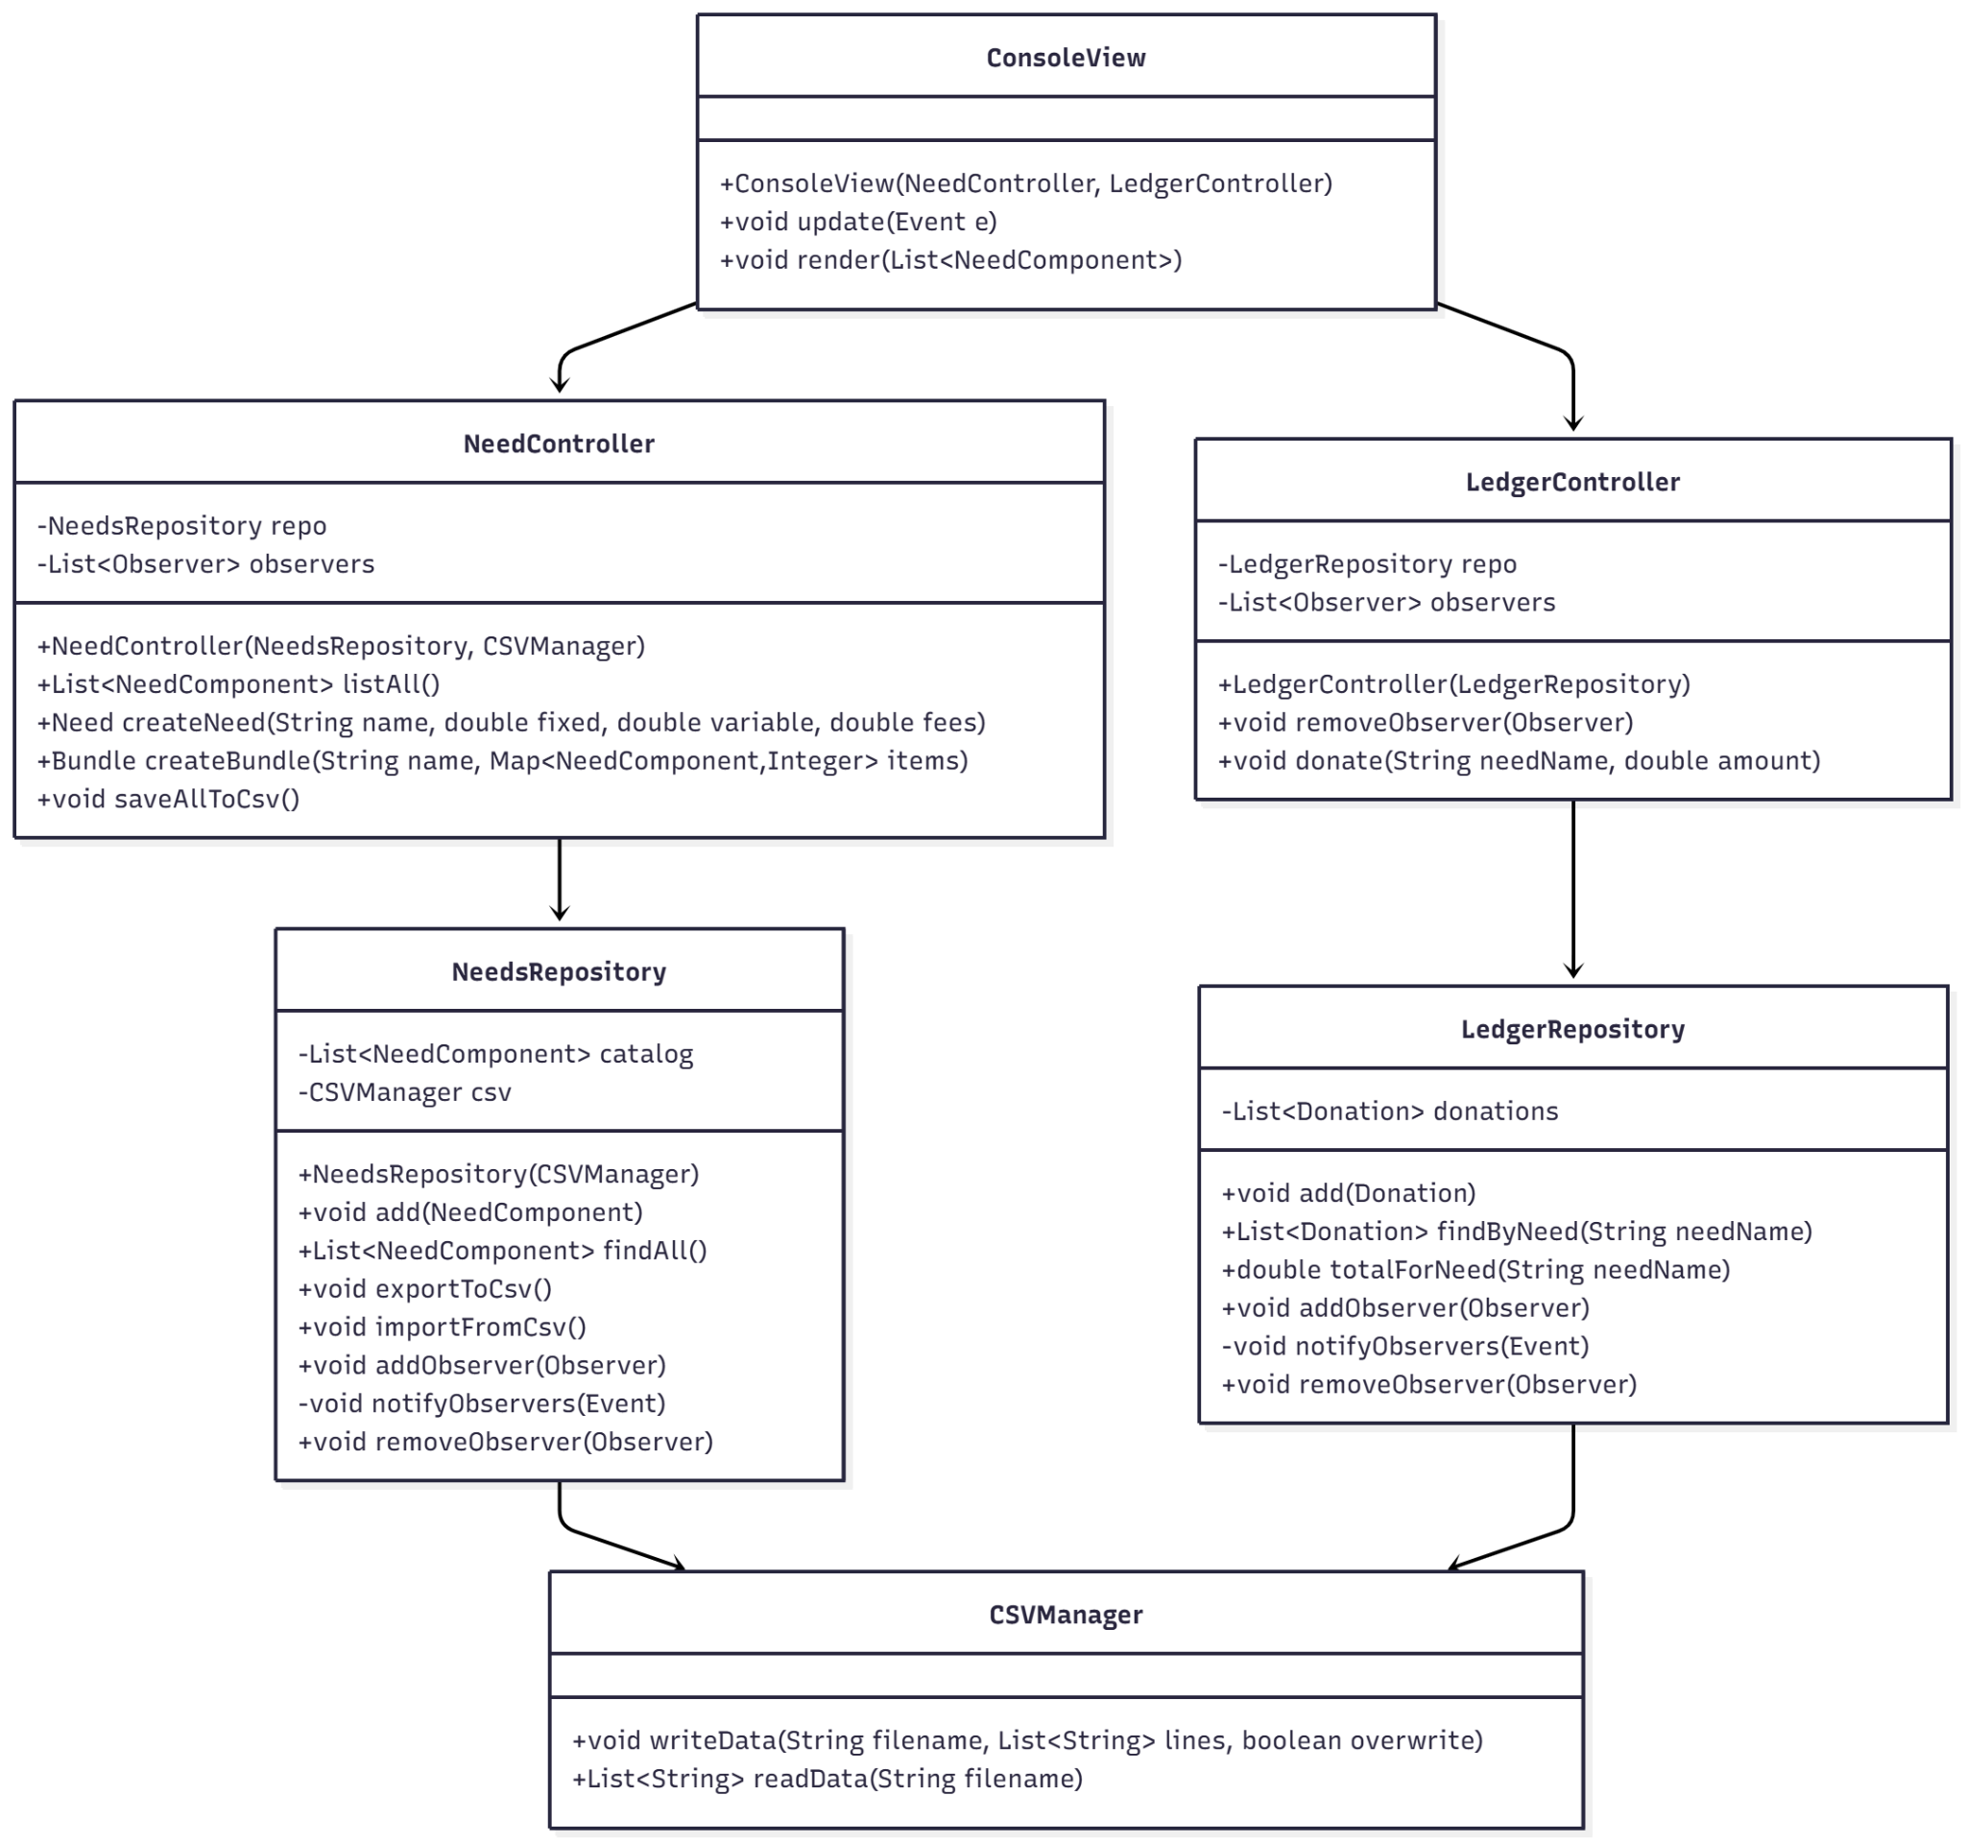
MVC Architecture
VIEW
Console/CLI
CONTROLLER
NeedsContr.
LedgerContr.
MODEL
Repos
CSV Manager
Notes:
Jon
“We implemented MVC to keep responsibilities clean. Controllers orchestrate actions, Models own state and business rules, Views render and react. Repositories sit behind interfaces so storage is swappable. That separation means we can evolve storage without touching domain logic or the view layer.”

Slide 7
Decisions and tradeoffs
Observer over polling → Event‑driven, lower coupling, instant updates
CSV/in‑mem now → Fast iteration, deterministic demos, simple seeding for testing.
Interface‑first Repos → Storage swap with no domain/controller changes
Central Ledger → One source of truth for donations/transactions
Drawbacks → Low cohesion for model components
Notes:
JON
“Decisions:
• Observer for immediate updates and low coupling.
• CSV/in-memory repos for deterministic demos and fast iteration.
• Interface-first repos to swap in DB later with no domain changes.
• Central Ledger as source of truth for transactions.
As a result of our implementation, we have low cohesion for our model components.”

Slide 8
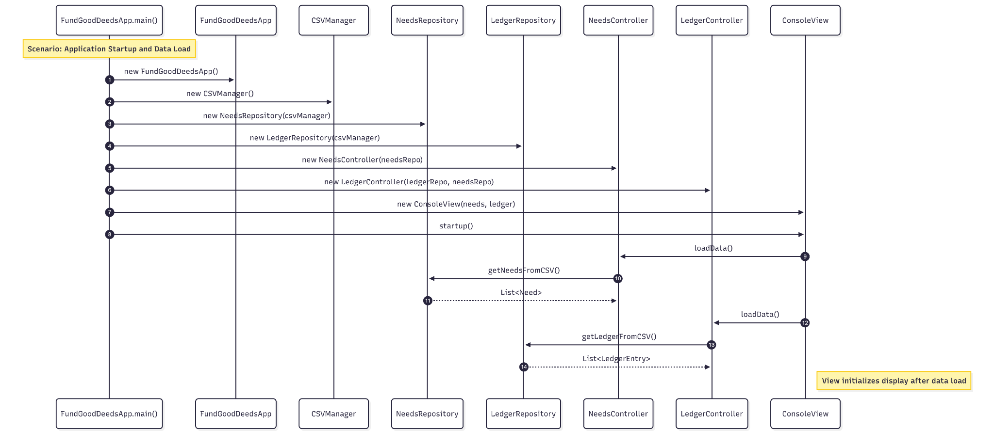
Startup Sequence
Notes:
OLIVER -

Slide 9
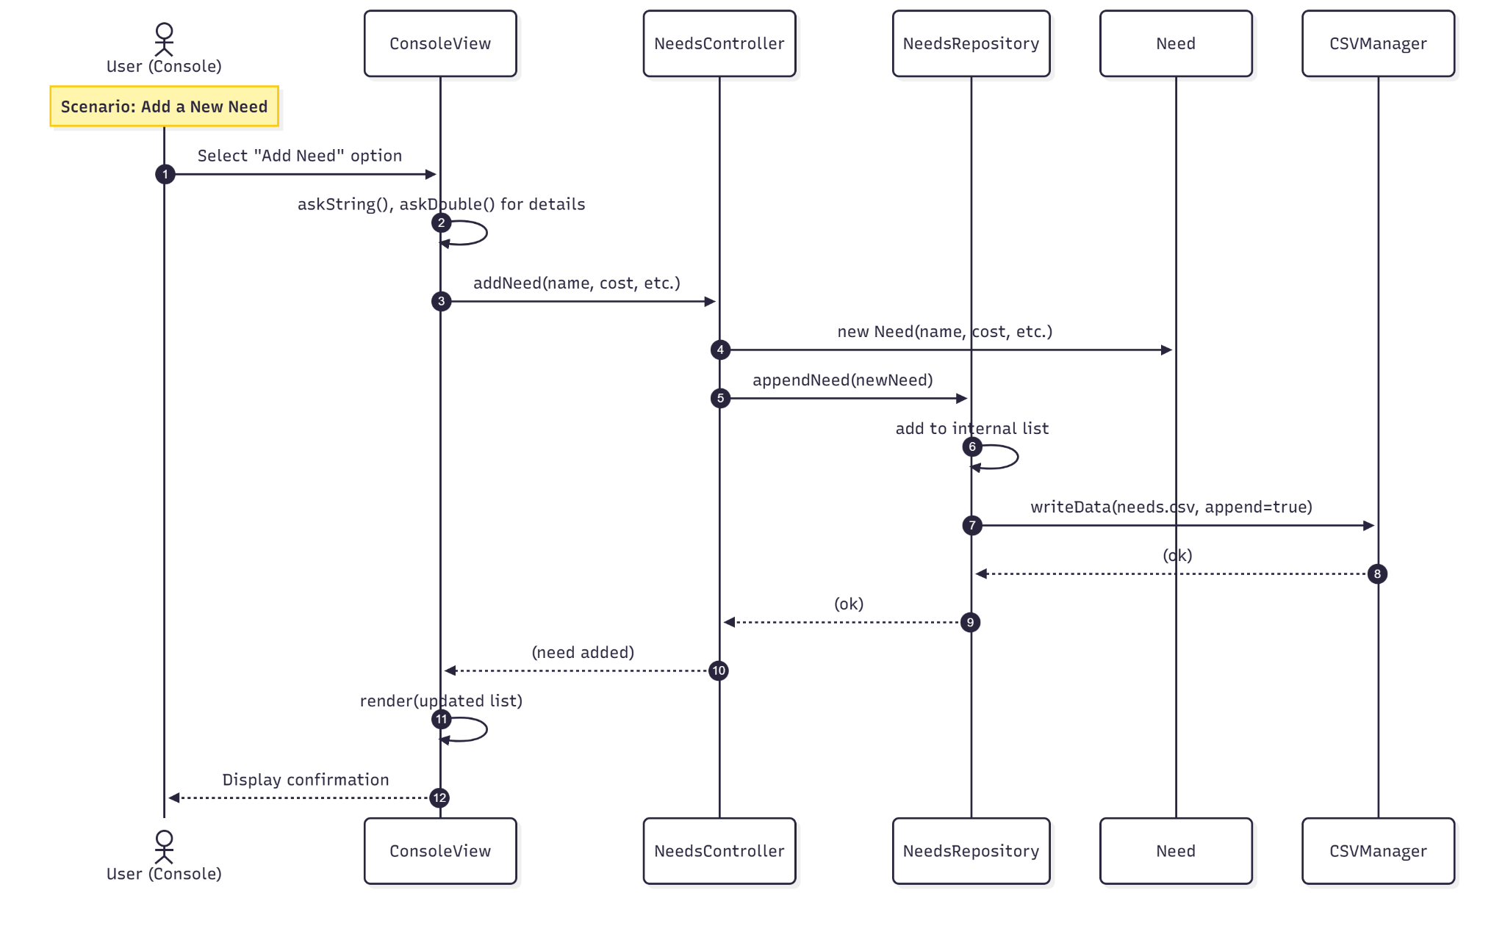
New Need
Sequence
Notes:
OLIVER

Slide 10
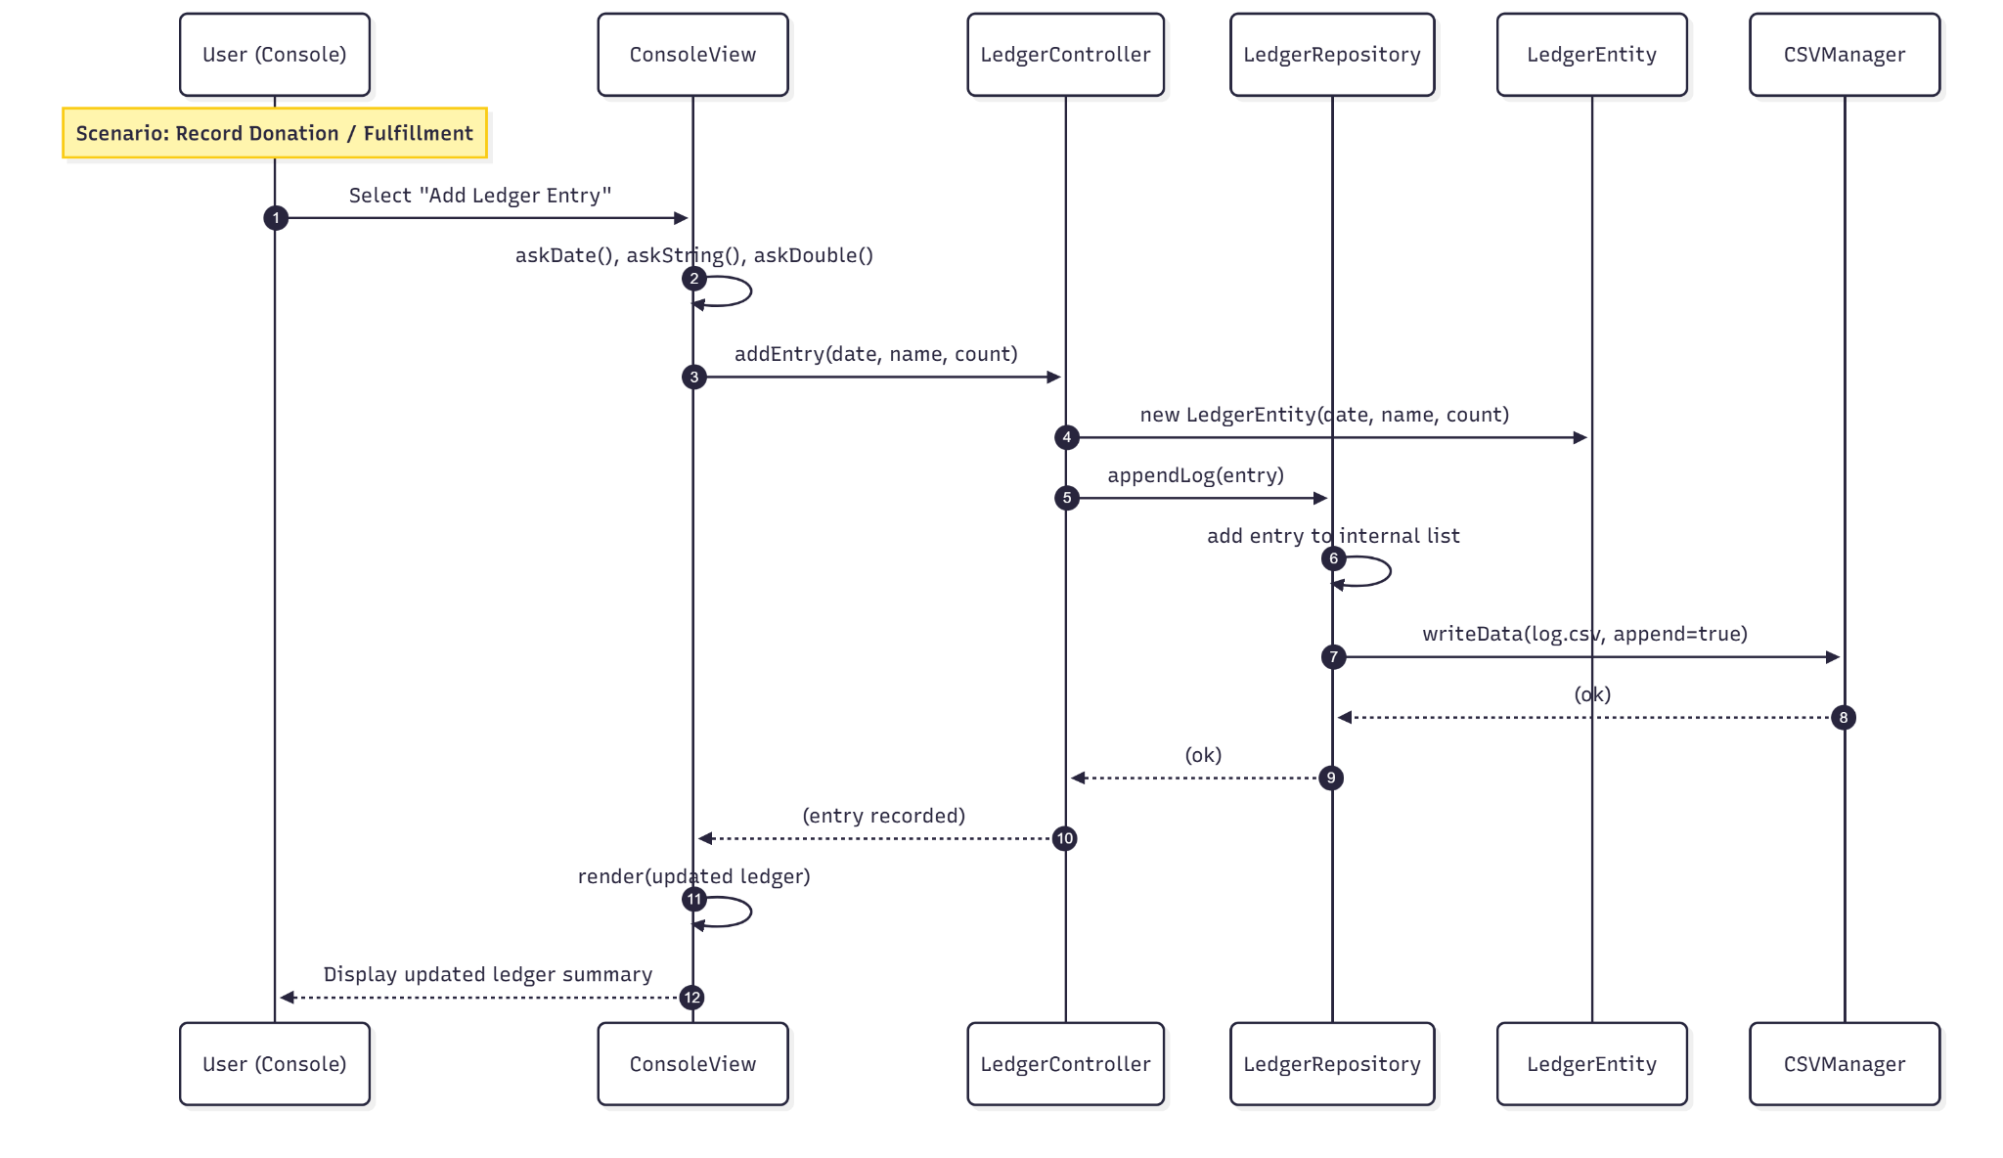
Adding to Ledger
Notes:
OLIVER

Slide 11
Live Demo
This demonstration showcases the Composite (Needs/Bundles) and Observer (Model updates View) patterns as the core of the application.
Key Demonstration Points:
Create a New Need (leaf) → Add a non-composite item to the catalog.
Record Fullfillment → Add a donation/fulfillment entry to the Ledger.
Observer in Action → Observe the instant [ALERT] messages that confirm the View is automatically updated when the Model changes.
Create a Bundle (Composite) → (if time allows) Assemble existing Needs into a new Bundle
Notes:
JON TALKING | PATRICK DEMONSTRATING
JON:
"To start the application, we pass the path to the ledger file as a command-line argument. The app initializes the MVC components and loads our starting data."
PATRICK:
In the root directory (term-project-rit-swen-383-01-1a), run these commands:
mvn clean compile
mvn exec:java -Dexec.args="log.csv"
JON:
“Please note that we have displayed the user’s current funds and today’s goal. Since we, the user, have never entered a fund, our system defaults to 150.0 dollars. Also, since we, the user, have never entered a funding goal, our system defaults to 2000.0 dollars.”
JON:
“I'll walk the core flow. First, let’s select option 1 to List needs & bundles.
PATRICK:
Enter 1
JON:
“Then let's select option 2 to create a new Need with a description and cost.”
PATRICK:
Enter these inputs for their respective prompts:
Need Name: Winter Coat
Fixed Cost: 80
Variable Cost: 0
Fees Cost: 5
JON:
“Now the Need has been created and added to our catalog as shown in the CLI stating ‘Need added.’; we can even list the catalog again to show it is there.”
PATRICK:
Enter 1
JON:
"Next, we use option 4 to record a fulfillment for that Need. This is our core donation/ledger flow."
PATRICK:
Date (YYYY-MM-DD, blank=today): (press Enter) Need/Bundle name: Winter Coat
Units fulfilled: 1
JON:
“Now the ledger entry has been created and saved to our memory ready to be added/saved into the ledger log CSV file, as shown in the CLI stating ‘Ledger entry added.’”
“Also, notice how when we added the donation of our Winter Coat need, the total cost of it is now added to the funds we have obtained to reach the goal.”
“Now let’s use option 5 to set a fund for today.”
PATRICK:
Enter 5
Date (YYYY-MM-DD, blank=today): (press Enter)
Funds amount: 200
JON:
“Now the funds for today has been recorded, as shown in the CLI returning the current funds are now 200.00 dollars and the message ‘Funds recorded’ when setting the fund for today.”
“Now let’s actually change today’s funding goal to be 3000 dollars. We do this by using option 6.”
PATRICK:
Enter 6
Date (YYYY-MM-DD, blank=today): (press Enter)
Goal amount: 3000
JON:
“Now the funding goal for today has been recorded, as shown in the CLI returning the funding goal is now 3000.00 dollars and the message ‘Goal recorded’ when setting the funding goal for today.”
“We will now save what we have done to the ledger and needs CSV files, and then exit the application.”
PATRICK:
Enter 8 to SAVE
Enter 0 to EXIT
JON:
“Notice that when we made these changes and saving, the Observer (View) is being notified by the Observable (Model) of the set changes as shown with our [ALERT] messages.”
PATRICK:
Show these messages in the terminal
[ALERT] Needs Catalog updated: null
[ALERT] Ledger updated: null
Everything has been saved to csv files.
If time allows, we’ll show a simple Bundle summarizing multiple Needs.”
If something glitches (say this calmly):
“Quick note: our view is event-driven. Even if this click doesn’t fire, the model still publishes events on donation; we can show the same behavior to illustrate the Observer linkage.”

Slide 12
Team Roles and challenges
Technical Roles:
Connor: View & Integration
Jon: Controllers & Business Logic (create/donate flows, wire repos ↔ model, Quality Assurance)
Patrick: Persistence & Repository (CSV read/write, storage logic, seeds)
Oliver: Domain & Composite (Need/Bundle design, Composite behavior, Quality Assurance)
Process: GitHub issues → PRs → reviews, one-command run.
Challenges → Mitigation: controller timing → mocks, seed consistency → CSV versioning, demo risk → backups + projector-safe fonts.
Ambiguities!!!
Notes:
Connor & Oliver
Roles: Connor handled view and integration, Jon the controllers and business logic, Patrick implemented persistence and repositories with CSV read/write and seeds, Oliver designed the domain and Composite.
Process: GitHub issues → PRs → reviews, one-command run.
Challenges: controller timing (mitigated with mocks), seed consistency (CSV versioning), and demo risk (backups and projector-safe fonts).

Slide 13
Next Steps & Q&A
Next
Visual UI probably SwingUI
Validation & error paths
Basic auth/roles
Better testing for edge cases
Bundle allocation strategies
Donation fulfillments are reflected in our Needs Catalog
Notes:
Connor & Oliver
That’s our V1.0. Thanks—and we’re ready for your questions.”
Q&A — Quick, crisp answers (keep these handy)
d, and expand tests around edge cases and bundles.
Q: Why Observer instead of periodic refresh?
A (Oliver): “Events keep views in sync immediately and reduce coupling—no timers or polling overhead.”
Q: Why CSV/in-memory now—won’t that limit you?
A (Connor): “It makes demos deterministic and fast. We built repository interfaces so we can drop in a DB without touching domain logic.”
Q: How do you enforce ‘no over-funding’?
A (Oliver): “The donation path guards the invariant, clamps fundedAmount at cost, sets isFulfilled, and ignores additional donations.”
Q: What’s mocked vs real?
A (Connor): “Some controller hooks are mocked, the events and state transitions are real. Replacing the mocks is our top next step.”
Q: What testing exists today?
A (Oliver): “Seeded scenario scripts and smoke tests across controller paths. After R1 we’ll add validation/error-path tests and bundle edge cases.”
Q: How would you scale or persist?
A (Connor): “Swap CSV repos with a DB implementation via the same interfaces, add indexing, transactions, and simple caching if needed.”
Q: Any security/auth?
A (Oliver): “Out of scope for V1.0 classroom demo, it’s on our roadmap once controllers are fully integrated.”

